Slide 1

New York City Taxi Fare Prediction
Bhaskar Das
Springboard Data Science Career Track, May 2019 cohort
Capstone Project 2 (GitHub Project Link)

Slide 2
Table of Contents
Problem Statement
Business Problem
Business Objective
Data Collection
Data wrangling
Exploratory Data Analysis (EDA)
Feature engineering
Model evaluation
Machine Learning
Conclusion

Slide 3
Problem Statement
Business Problem:
The New York City Taxi fare prediction is a supervised regression problem
This problem demonstrates the importance of feature engineering
Most of the features need to be discovered based on business knowledge to generate accurate predictions.
Business Objective:
Build a model to accurately predict the taxi fare based on the pickup and dropoff location

Slide 4
Data Collection
Data source: https://www.kaggle.com/c/new-york-city-taxi-fare-prediction/data
The data contains three files, and the training data file has eight features that provide the details of yellow taxi rides in New York City.
Data Features:
key: ID variable that provides a unique string to identify each row.
fare_amount: Target variable that provides the amount of the taxi ride in dollars.
pickup_datetime: It provides the start of the taxi ride as a timestamp.
pickup_longitude: Longitude coordinate of the pickup location.
pickup_latitude: Latitude coordinate of the pickup location.
dropoff_longitude: Longitude coordinate of the dropoff location.
dropoff_latitude: Latitude coordinate of the dropoff location.
passenger_count: The number of passengers in the taxi ride.

Slide 5
Data wrangling
Data wrangling is a set of activities that prepare the raw data by cleaning them and make them usable for the analytical algorithms.
Missing value treatment:
Missing data can lead to wrong predictions
Removed the records with missing values
Outlier Detection and Treatment: We will find the variables which contain outliers and removed them
Fare Amount:
The fare amount variable contains outliers.
It contains negatives, zeroes, and values less than the minimum fare amount, which is highly unlikely events.
This variable shows few entries of fare amount greater than $100, which are likely to be outliers.

Slide 6
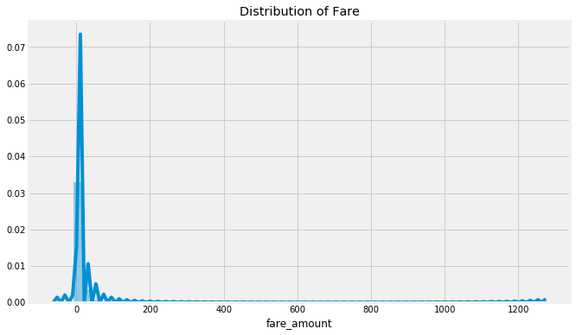
Data wrangling [contd.]
Fare Amount:
We have considered the fare amount between $2.5 and $100.
Fig. Distribution of Fare

Slide 7
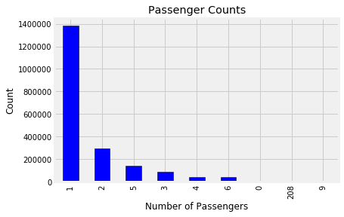
Data wrangling [contd.]
Passenger Counts:
We assume that a taxi is a vehicle whose body type is a sedan
The maximum number of passengers can be 5
We remove the records where the passenger count is 0
Fig. Passenger counts per trip
Location Data:
latitude and longitude data
We have found the 2.5% and 97.5% percentile values of the latitude and longitude columns to remove the outliers.

Slide 8
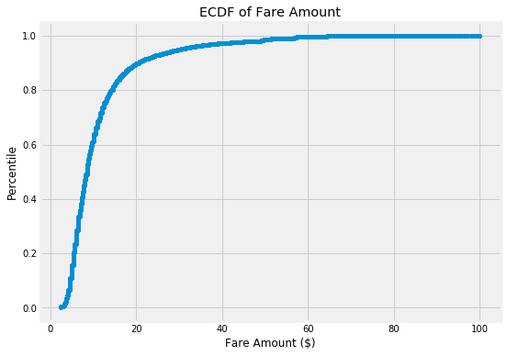
Exploratory Data Analysis (EDA)
EDA finds trends, anomalies, patterns, or relationships within the data.
EDA helps us to learn more about our data.
Fare Amount:
Most of the rides are below $20

Slide 9
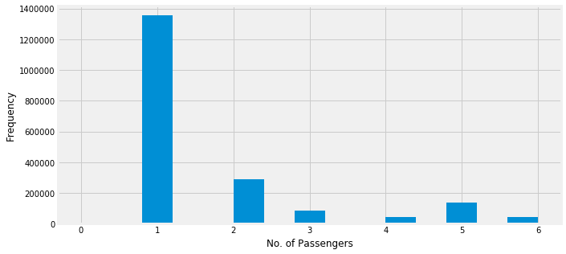
Exploratory Data Analysis (EDA) [contd.]
Relationship between the number of passengers and fare:
Single passengers are the most frequent travelers

Slide 10
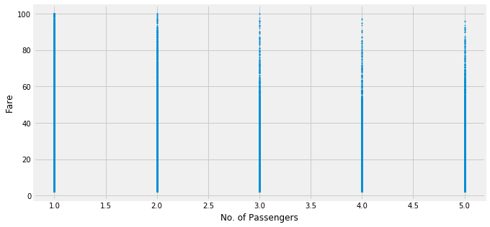
Exploratory Data Analysis (EDA) [contd.]
Relationship between the number of passengers and fare:
Taxi receives the highest fares when they carry single passengers

Slide 11
Feature engineering
We have created new features from the input data to build an accurate machine learning model.
Distance: The first feature we create is distance. We compute the distance from the pickup and dropoff latitudes and longitudes values by using the Haversine formula.
passenger_count: We have analyzed that the 'passenger_count' variable does not have an impact on the 'fare_amount' when the distance is constant.
Therefore, we remove the 'passenger_count' column from our machine learning model.
We have created the new features, ‘year’, ‘month’, ‘date’, ‘hour’, and ‘day_of_week’ from the ‘pickup_datetime’ variable.

Slide 12
Feature engineering [contd.]
'dt' : We have created a new feature 'dt' from the 'hour' variable.
Consists of four values, 'Morning', 'Afternoon', 'Evening', or 'Night'.
From 6 to 11 am is ‘Morning’.
'Afternoon' represents the value between 12 noon to 5 pm.
'Evening' represents the hour value between 6 pm to 11 pm, and
'Night' represents the rest of the hour values.
'mn': We have added the month name as a new variable 'mn' based on the numeric value from the 'month' variable.
We have calculated the relative distances from the pickup and dropoff latitude and longitude values and added as new columns.

Slide 13
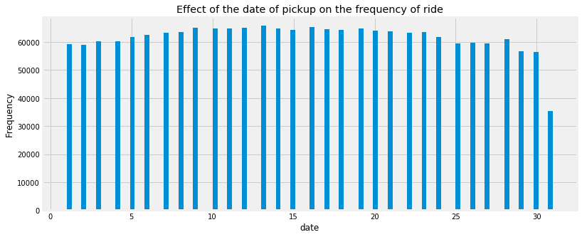
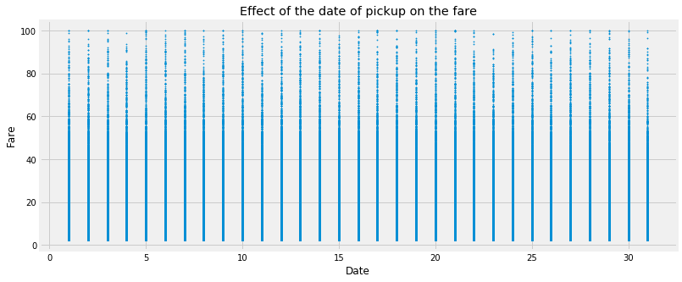
Feature engineering [contd.]
Effect of the date of pickup on the frequency of ride:
frequency of ride and the fare are not affected by the date.

Slide 14
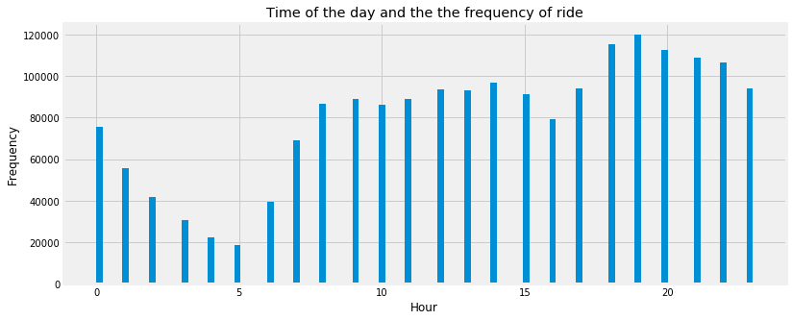
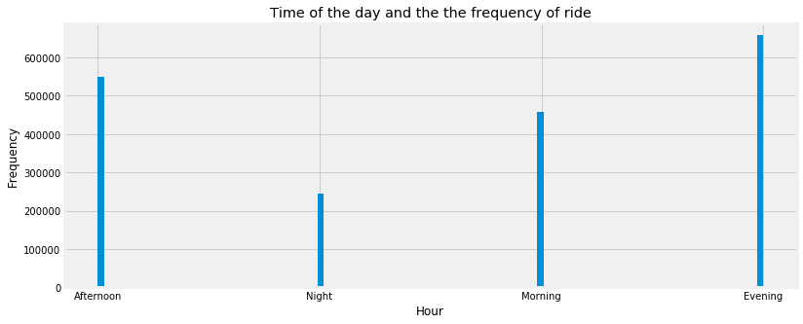
Feature engineering [contd.]
Effect of the date of pickup on the frequency of ride:
The time of the day affects the frequency of the rides.
Morning 5 sees the lowest and evening 7 being the highest.

Slide 15
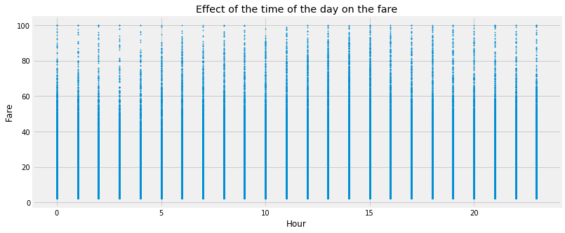
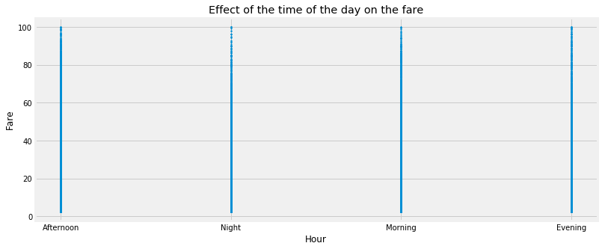
Feature engineering [contd.]
Effect of the date of pickup on the frequency of ride:
The fare is high between 5 AM to 9 AM and 1 PM to 4 PM.

Slide 16
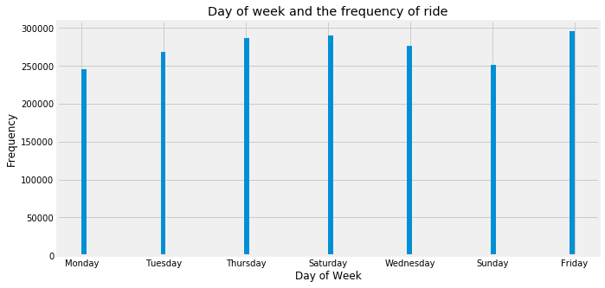
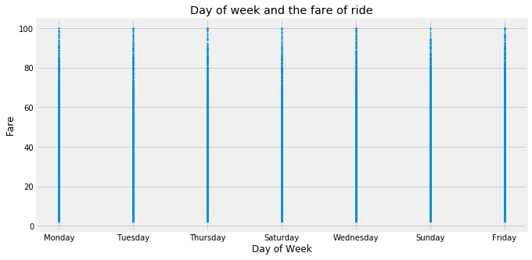
Feature engineering [contd.]
Effect of the day of the week on the fare:
The week does not seem to have much of an influence on the number of taxi rides.
The frequency of rides increases on Thursday and decreases on Sunday and Monday.

Slide 17
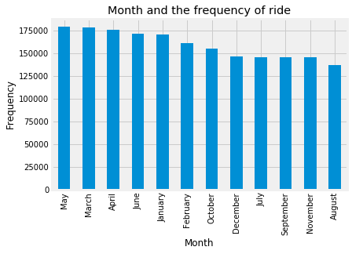
Feature engineering [contd.]
Effect of the month on the fare:
The first half of the year observed more rides than the second half of the year.

Slide 18
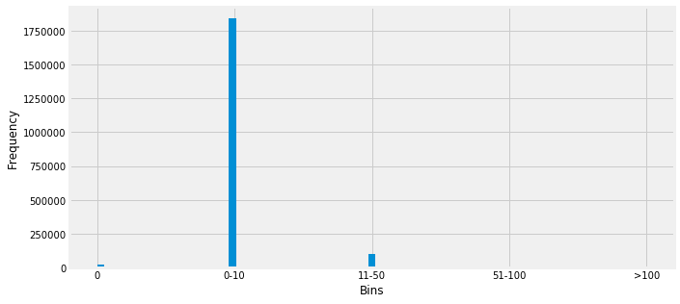
Feature engineering [contd.]
Effect of the distance on the fare:
We will delete all records where distance is 0 km, but the fare amount is not $0.

Slide 19
Feature engineering [contd.]
Encoding categorical variables: We have encoded the following variables with one-hot encoding.
'date': The date variable does not show any change in the fare. Therefore, we have encoded it.
'year': The year variable does not show any difference in the fare based on the increase or decrease in the year.
'passenger_count': The fare remains unaffected by the number of passengers riding in a taxi.
The object type variables, such as the month, week, and time of the day are also encoded.

Slide 20
Feature engineering [contd.]
Feature selection:
Finally, we have deleted the following features from our model:
'month', 'hour', 'year', 'date', 'pickup_datetime', 'passenger_count','pickup_longitude', 'pickup_latitude', 'dropoff_longitude', 'dropoff_latitude', 'distance'.
We have found out that the relative distance of the latitude and longitude values produces a better model than the one with the distance feature.
Therefore, we have removed the feature distance in favor of the relative distance.

Slide 21
Model evaluation
To evaluate our model, we will use two metrics, root mean squared error and mean absolute percentage error.
Root mean squared error (RMSE): measures the difference between the predictions of a model, and the corresponding ground truth.
Mean absolute percentage error (MAPE): gives the average percentage error of the predictions.

Slide 22
Machine Learning
We have used multicollinearity analysis to remove the variables which are highly linearly correlated with another variable.
The resultant multicollinearity analysis removed the six features, wk_Friday, dt_Afternoon, mn_April, dd_1, yr_2009, pc_1.
We have tuned the parameters of the light GBM model using GridSearchCV, and the resultant values are, 'learning_rate': 0.1, 'max_depth': 10, 'num_leaves': 31.
We have evaluated three models for this project, which are XGBoost, random forest, lightGBM. The following are the rmse and mape score of each of them:
Model | RMSE | MAPE
XGBoost | 8.6 | 31.35
random forest | 3.75 | 19.94
lightGBM | 3.65 | 18.66

Slide 23
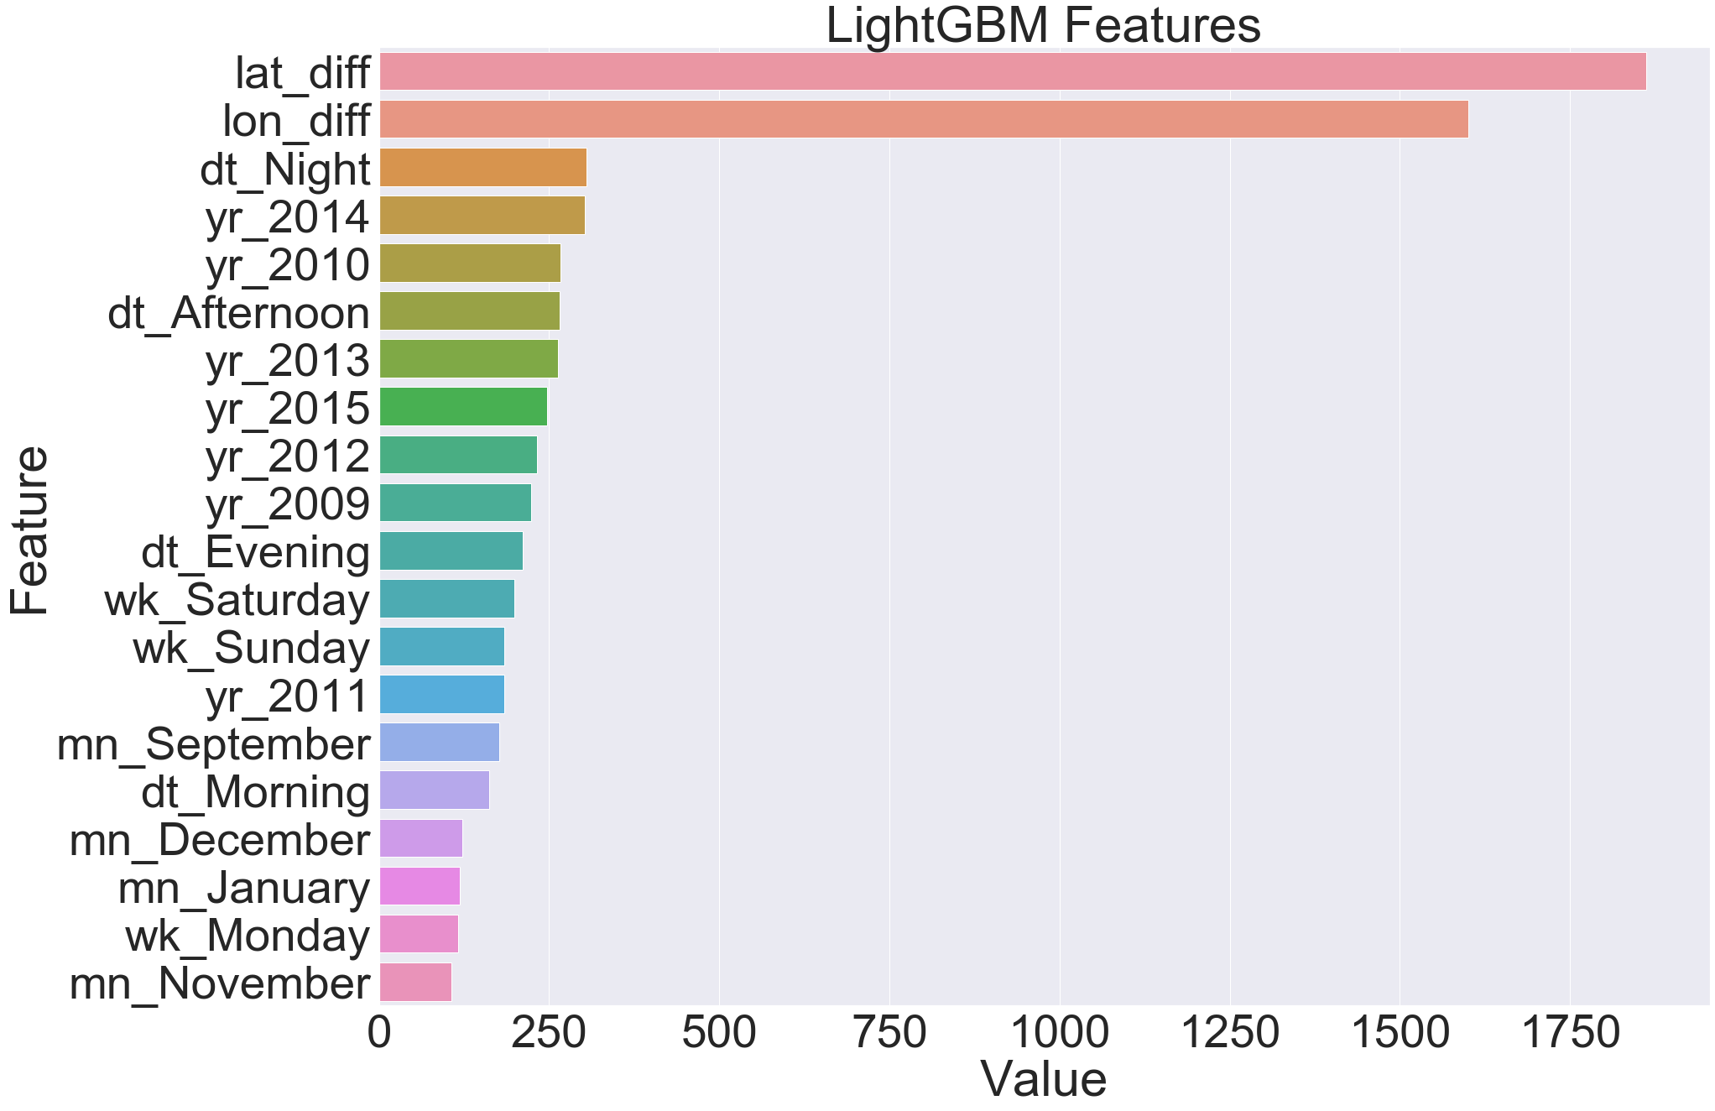
Machine Learning [contd.]
Light Gradient Boosting:

Slide 24
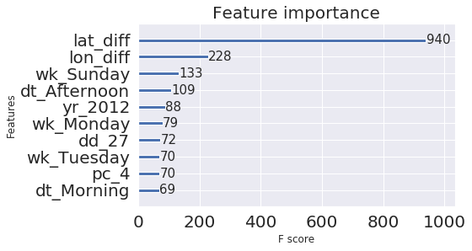
Machine Learning [contd.]
XGBoost with Multicollinearity:

Slide 25
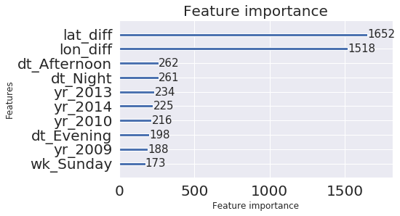
Machine Learning [contd.]
Light Gradient Boosting with Multicollinearity:

Slide 26
Machine Learning [contd.]
Algorithm | RMSE | MAPE
Linear Regression | 5.07 | 26.01
Light Gradient Boosting | 3.67 | 18.97
Random Forest | 3.75 | 19.98
XGBoost with Multicollinearity | 8.58 | 31.36
Random Forest with Multicollinearity | 3.74 | 19.07
Light Gradient Boosting with Multicollinearity | 3.67 | 18.93
Light Gradient Boosting with Multicollinearity and Parameter tuning | 3.65 | 18.67

Slide 27
Conclusion
In this project, we have achieved a MAPE score of 18.67%
This project demonstrates the importance of feature engineering.
Here, we have created most of the features of the existing data.
We have used the multicollinearity analysis to increase the accuracy of our model by removing collinear variables.
Finally, we have fine-tuned the parameters of the LightGBM algorithm using GridSearchCV to improve our model.
The feature importance evaluated by the LightGBM model illustrates that the most important ones are the lat_diff and lon_diff variables.
We have created these two variables from the pickup and dropoff latitude and longitude data.

Slide 28
Thank You

